Slide 1
2021 Benchmark Assessment 2
Errick L. Greene, Ed.D.
Superintendent

Slide 2
Vision, Mission, and Goals
At Jackson Public Schools, we prepare scholars to achieve globally, to contribute locally, and
to be fulfilled individually.
Vision
At Jackson Public Schools, we develop scholars through world-class learning experiences to attain an
exceptional knowledge base, critical and relevant skill sets, and the necessary dispositions for great
success.
Mission
At Jackson Public Schools, we believe in the importance of equity, excellence, growth
mindset, relationships, relevance, and positive and respectful cultures.
Core Values

Slide 3
Purpose
The purpose of this presentation is to share district goals, outline yearly goals, provide an overview of benchmark 2 data, discuss where we are in terms of proficiency, and outline next steps based on data.
Overview

Slide 5
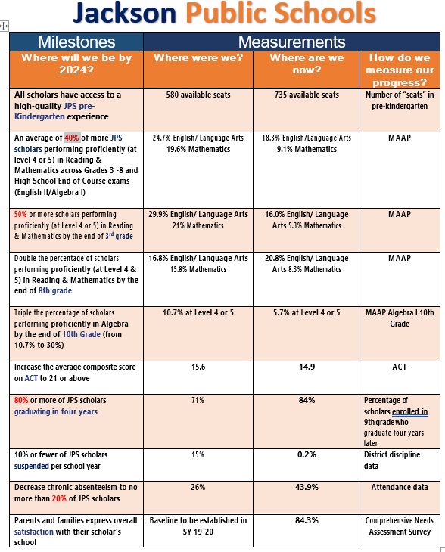
Jackson Public Schools
Highlights
Identifies each milestone
Where were we pre-pandemic?
Where are we now?
How we plan to measure progress?

Slide 7
Benchmark Two (2) Participation Rates

Slide 8
Participation Rates
Notes:
8677 – two data points- ELA

Slide 9
2021 – 2022 Benchmark Data
PROFICIENCY
Subject | BM1 21 - 22 |  | BM2 21 - 22 | % of Change
English | 19.2% |  | 24.1% | + 4.9
Mathematics | 17.8% |  | 20.2% | + 2.4
Science | 30.1% |  | 31.6% | + 1.5
History | 23.4% |  | 30.6% | +7.2
District

Slide 10
ELA Proficiency

Slide 11
Elementary/Middle Division
PROFICIENCY
Grade | BM1 21 - 22 |  | BM2 21 - 22 | % of Change
3rd Grade | 18.9% |  | 25.0% | +6.1
4th Grade | 20.7% |  | 27.1% | +6.4
5th Grade | 21.0% |  | 28.0% | +7.0
6th Grade | 13.2% |  | 19.3% | +6.1
7th Grade | 17.7% |  | 21.1% | +3.4
8th Grade | 25.8% |  | 22.5% | -3.3
ELA

Slide 12
Proficiency

Slide 13
Elementary School Division
PROFICIENCY
 | BM1 |  | BM2 | % of Change
3rd Grade | 16.4% |  | 17.2% | +0.8
4th Grade | 18.2% |  | 21.4% | +3.2
5th Grade | 17.5% |  | 20.9% | +3.4
MATH

Slide 14
Middle School Division
PROFICIENCY
 | BM1 |  | BM2 | % of Change
6th Grade | 19.3% |  | 20.1% | +0.8
7th Grade | 21.6% |  | 24.3% | +2.7
8th Grade | 16.0% |  | 19.1% | +3.1
8th Grade/Algebra I | 21.0% |  | 27.2% | +6.2
MATH

Slide 15
Science Proficiency

Slide 16
Science
PROFICIENCY
 | BM1 |  | BM2 | % of Change
5th Grade | 35.2% |  | 41.0% | +5.8
8th Grade | 25.7% |  | 26.7% | +1.0
Science

Slide 17
High School Proficiency

Slide 18
High School Division
PROFICIENCY
 | BM1 |  | BM2 | % of Change
English II | 21.8% |  | 23.1% | +1.3
Algebra I | 15.0% |  | 18.8% | +3.8
Biology I | 29.1% |  | 26.4% | -2.7
US History | 23.4% |  | 30.6% | +7.2
Subject Area

Slide 19
Subgroup Population

Slide 20
ENGLISH PROFICIENCY
Notes:
3rd and 4th (8-9% prof)

Slide 21
MATHEMATICS PROFICIENCY
Notes:
EL
3rd Grade -10.8%
4th Grade - 7.8%
HS - 3.8%

Slide 22
US HISTORY PROFICIENCY

Slide 23
SCIENCE PROFICIENCY

Slide 24
International Baccalaureate (IB)

Slide 25
International Baccalaureate (IB)

Slide 26
International Baccalaureate (IB)

Slide 27
Academic and Performing Arts Complex (APAC)

Slide 28
Academic and Performing Arts Complex (APAC)

Slide 29
Academic and Performing Arts Complex (APAC)

Slide 30
Low Performing Standards

Slide 31
ELA - Low Performing Standards (Elementary)
RI.3.3 – 38.0%
Describe the relationship between a series of historical events, scientific ideas or concepts, or steps in technical procedures in a text, using language that pertains to time, sequence, and cause/effect.
RI.4.1 – 29.0%
Refer to details and examples in a text when explaining what the text says explicitly and when drawing inferences from the text.
RI.5.8 - 42.8%
Explain how an author uses reasons and evidence to support particular points in a text, identifying which reasons and evidence support which point(s).

Slide 32
ELA - Low Preforming Standards (Secondary)
RI.6.8 -34%
Trace and evaluate the argument and specific claims in a text, distinguishing claims that are supported by reasons and evidence from claims that are not.
RL.7.1 - 26%
Cite several pieces of textual evidence to support analysis of what the text says explicitly as well as inferences drawn from the text.
RI.8.3 -28.8%
Analyze how a text makes connections among and distinctions between individuals, ideas, or events (e.g., through comparisons, analogies, or categories).
L.10.5 – 34.6%
Demonstrate understanding of figurative language, word relationships, and nuances in word meanings.
RI.10.6 – 36.0%
Determine an author’s point of view or purpose in a text and analyze how an author uses rhetoric to advance that point of view or purpose.
Notes:
RI.8.6 – 50.8
RL.10.1 – 53.2% - Cite strong and thorough textual evidence to support analysis of what the text says explicitly as well as inference drawn from the text.

Slide 33
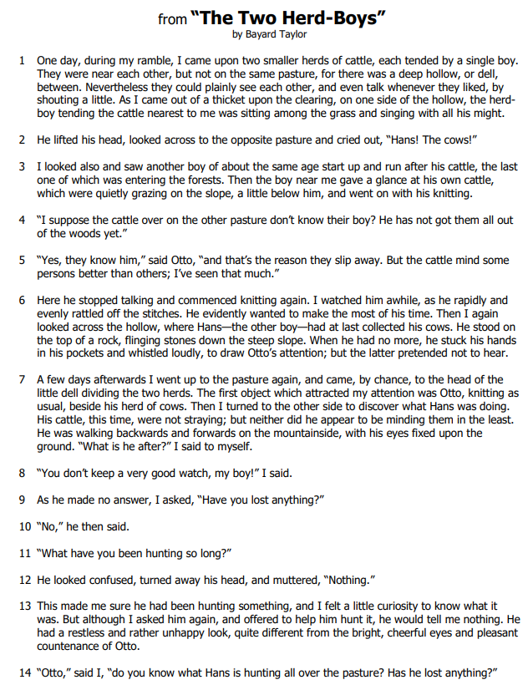
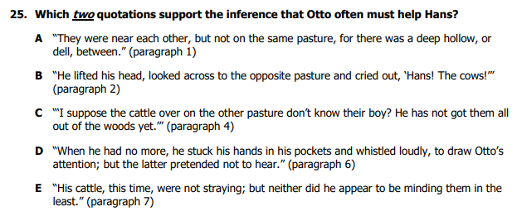
7th Grade ELA Item Analysis – RL.7.1

Slide 34
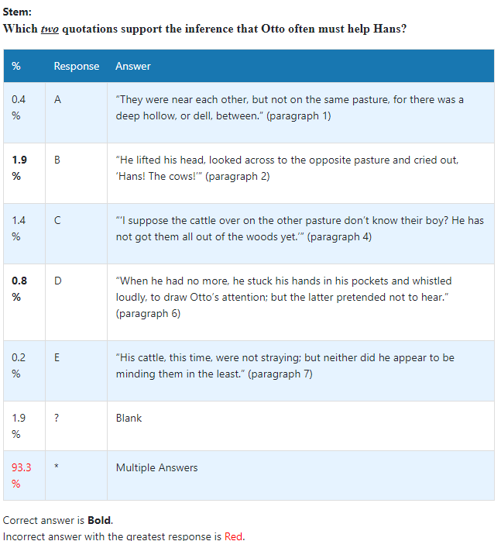
7th Grade ELA Item Analysis – RL.7.1

Slide 35
7th Grade ELA Item Analysis – RL.7.1
For this item, highlight the answer by hovering over and selecting the underlined text.
Select one underlined quotation from the text that supports the inference that the narrator can be cunning.
Notes:
DOK 1

Slide 36
Math - Low Performing Standards (Elementary)
3.NF.3 – 32.1%
Explain equivalence of fractions in special cases, and compare fractions by reasoning about their size.
4.NBT.5 – 39.1%
Multiply a whole number of up to four digits by a one-digit whole number, and multiply two two-digit numbers, using strategies based on place value and the properties of operations. Illustrate and explain the calculation by using equations, rectangular arrays, and/or area models..
5.NF.2 – 33.1%
Solve word problems involving addition and subtraction of fractions referring to the same whole, including cases of unlike denominators, e.g., by using visual fraction models or equations to represent the problem. Use benchmark fractions and number sense of fractions to estimate mentally and assess the reasonableness of answers.
Notes:
Use place value understanding to round multi-digit whole numbers to any place. – 4th Grade

Slide 37
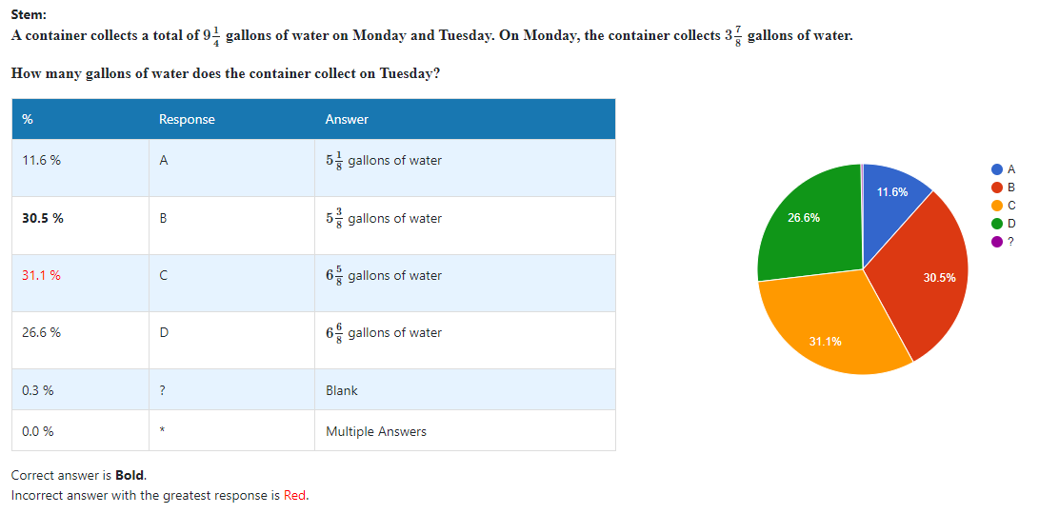
5th Grade Math Item Analysis – 5.NF.2

Slide 38
Math - Low Performing Standards (Secondary)
6.R.P.3 – 34.9%
Use ratio and rate reasoning to solve real-world and mathematical problems, e.g., by reasoning about tables of equivalent ratios, tape diagrams, double number line diagrams, or equations.
7.EE.3 – 39.9%
Solve multi-step real-life and mathematical problems posed with positive and negative rational numbers in any form (whole numbers, fractions, and decimals), using tools strategically. Apply properties of operations to calculate with numbers in any form; convert between forms as appropriate; and assess the reasonableness of answers using mental computation and estimation strategies.
8.G.2 – 34.0%
Understand that a two-dimensional figure is congruent to another if the second can be obtained from the first by a sequence of rotations, reflections, and translations; given two congruent figures, describe a sequence that exhibits the congruence between them.
F-LE.1(HS) - 37.8%
Distinguish between situations that can be modeled with linear functions and with exponential functions.
F-IF.5 (MS) – 21.6%
Relate the domain of a function to its graph and, where applicable, to the quantitative relationship it describes.

Slide 39
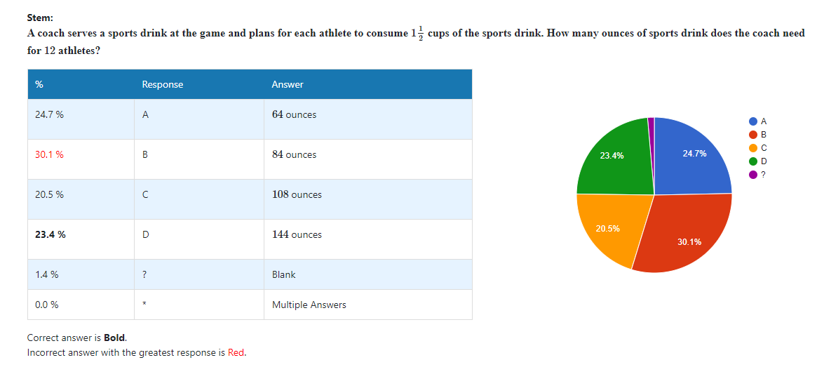
6th Grade Math Item Analysis – 6.RP.3

Slide 40
Science/History - Low Performing Standards
L.5.3A.1 – 43.2%
Research and communicate the basic process of photosynthesis that is used by plants to convert light energy into chemical energy that can be stored and released to fuel an organism’s activities.
BIO.1B.1
Develop and use models to compare and contrast the structure and function of carbohydrates, lipids, proteins, and nucleic acids (DNA and RNA) in organisms.
E.8.10.3 – 34.6%
Using scientific data, debate the societal advantages and disadvantages of technological advancements in renewable energy sources.
US.1.3 – 37.2%
Evaluate the Dawes Act for its effect on tribal identity, land ownership, and assimilation of American Indians.

Slide 41
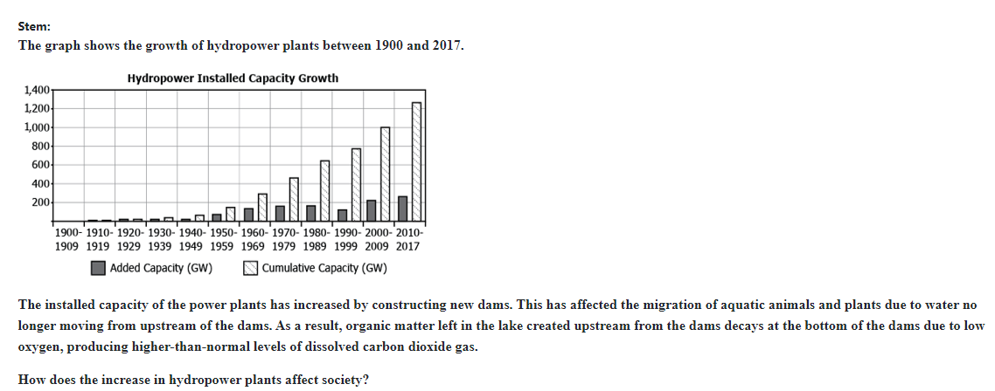
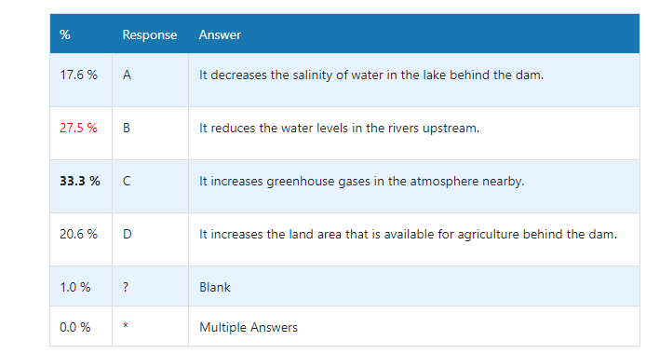
8th Grade Science Item Analysis – E.8.10.3

Slide 42
Benchmark 1 Top 10 and Bottom 10 Schools: English
Overall English Top & Bottom 10 Schools with Percent of Students at Proficient and Advanced (PL 4 & 5)
Top 10 Schools | % PL 4 & 5 | Bottom 10 Schools | % PL 4 & 5
Obama Magnet School | 82% | Sykes Elementary School | 14%
Lester Elementary School | 62% | Brinkley Middle School | 14%
McWillie Elementary School | 60% | Powell Middle School  | 13%
Bailey Middle APAC | 52% | Cardozo Middle School  | 13%
North Jackson Elementary School | 52% | Baker Elementary School | 12%
Northwest Middle School | 50% | Wilkins Elementary School  | 12%
Casey Elementary School | 47% | Provine High School  | 12%
Key Elementary School | 40% | Oak Forest Elementary School  | 11%
Marshall Elementary School | 39% | Blackburn Middle School | 10%
Peeples Middle School | 33% | Boyd Elementary School  | 9%

Slide 43
Benchmark 1 Top 10 and Bottom 10 Schools: Mathematics
Overall Mathematics Top & Bottom 10 Schools with Percent of Students at Proficient and Advanced (PL 4 & 5)
Top 10 Schools | % PL 4 & 5 | Bottom 10 Schools | % PL 4 & 5
Obama Magnet School | 66.3% | Jim Hill High School | 8.9%
Bailey Middle APAC | 58.4% | Clausell Elementary School | 8.2%
Isable Elementary School | 50.0% | Pecan Park Elementary School  | 8.0%
Northwest Middle School | 48.5% | Powell Middle School | 8.0%
Lester Elementary School | 45.1% | Cardozo Middle School | 6.8%
Peeples Middle School | 39.0% | Bates Elementary School  | 6.5%
McWillie Elementary School | 38.3% | Oak Forest Elementary School  | 5.5%
Casey Elementary School | 37.2% | Smith Elementary School | 3.8%
Lake Elementary School | 35.7% | Boyd Elementary School  | 3.2%
Lanier High School | 33.3% | Raines Elementary School  | 1.7%
Notes:
Raines – 4th -5th grade students (0% prof)

Slide 44
Benchmark 1 Top 10 and Bottom 10 Schools: Science
Overall Science Top & Bottom 10 Schools with Percent of Students at Proficient and Advanced (PL 4 & 5)
Top 10 Schools | % PL 4 & 5 | Bottom 10 Schools | % PL 4 & 5
Obama Magnet School | 90% | Chastain Middle School | 20%
Lester Elementary School | 80% | Boyd Elementary School | 20%
Wilkins Elementary School | 76% | Clausell Elementary School  | 18%
John Hopkins Elementary School | 73% | Smith Elementary School  | 18%
Wells APAC School | 71% | Blackburn Middle School | 15%
Casey Elementary School | 68% | Walton Elementary School | 13%
Galloway Elementary School | 64% | Powell Middle School | 11%
North Jackson Elementary School | 61% | Whitten Middle School  | 11%
Key Elementary School | 59% | Provine High School  | 11%
Spann Elementary School | 59% | Oak Forest Elementary School  | 5%

Slide 45
Next Steps

Slide 46
Next Steps Towards Proficiency
Review a comprehensive standard analysis report from BM 1 and BM 2 to determine 1st semester strengths and weaknesses.
Look closely at the standards provided during professional development to discuss strategies and look-fors with coaches and consultants.
Identify “bubble students” strengths and weaknesses for reteaching, remediation, and enrichment.
Provide/review training on Norman Webb’s Depth of Knowledge
75% of the ELA and Math assessment will be written at a level 2
65 – 85% of the Science assessment will be written at a level 2

Slide 47
Next Steps Towards Proficiency
Continue coaching building-level leaders to lead discussions with teachers about misconceptions, misunderstandings and during FIT meetings and PLCs.
Review Exceptional Education student’s IEPs to ensure all they are receiving accommodations appropriate strategies.
Encourage teachers to communicate with students and parents utilizing CASE21 student individualized report.

